Slide 1
Feedforward Neural Networks (FNN) Using Python
Building and training FNNs with PyTorch and TensorFlow

Slide 2
Contents
01
02
Recap :Neural Networks
Understanding FNN Architecture
03
04
Implementing FNN using PyTorch and TensorFlow
Comparison of Deep Learning Frameworks

Slide 3
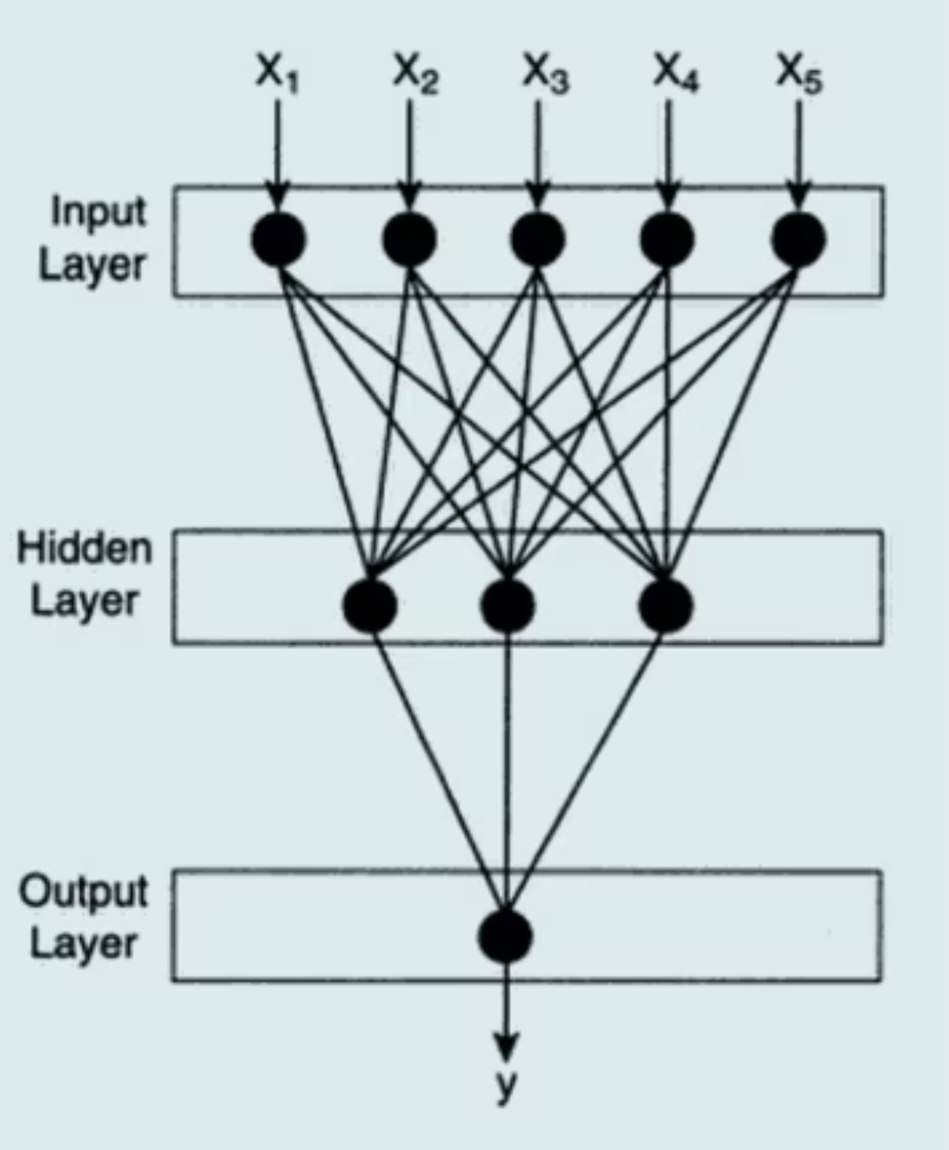
Recap: What is a Neural Network?
A Neural Network is a machine learning model inspired by the human brain — interconnected neurons that learn patterns from data.
Neural Network Training Pipeline
1. Input Data
2. Forward Pass
3. Compute Loss
4. Backpropagation
5. Update Weights
Repeat until model learns patterns

Slide 4

Definition of Feedforward Neural Network
The simplest type of Artificial Neural Network — information moves in one direction only:
Input → Hidden Layer(s) → Output. No cycles or feedback connections.
Learns patterns by adjusting weights during training using data.
Commonly used for classification and regression tasks.
Key Idea: Each neuron receives input, applies a transformation, and passes output to the next layer.

Slide 5
Components of FNN
Input Layer
1
Receives raw features
Hidden Layer(s)
2
Learns complex relationships
Output Layer
3
Produces final prediction
Weights & Bias
4
Connection strength & activation threshold
Activation Function
5
Introduces non-linearity

Slide 6
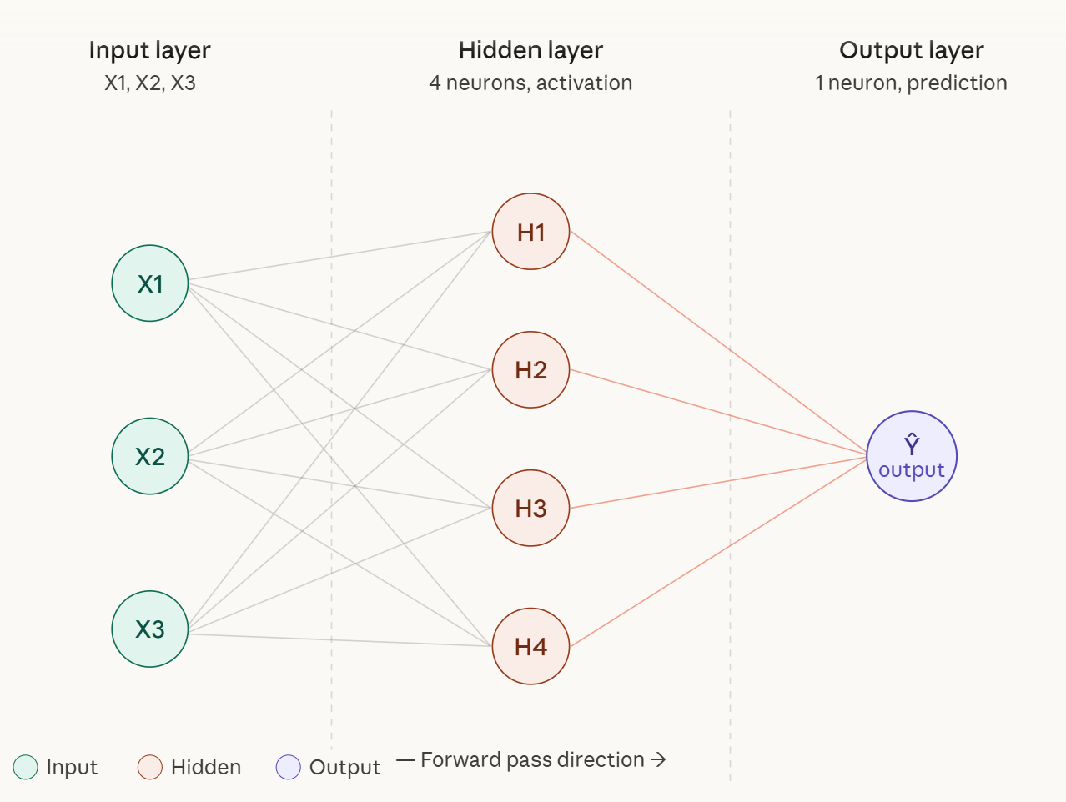
Simple Architecture
A basic FNN: 3 input features → 1 hidden layer (4 neurons) → 1 output neuron.
Simple Feedforward Network
Each neuron computes: Output = Activation( Σ(Weight × Input) + Bias )

Slide 7
Mathematical Representation
For each neuron, the computation follows two steps:
z: Weighted sum of inputs + bias (linear combination)
a: Activated output passed to next layer
Common activation functions: ReLU, Sigmoid, Tanh. This process repeats layer by layer.

Slide 8

Training Process in FNN
Objective: Minimize prediction error through four sequential steps.
Loss Calculation
Forward Propogation
Backpropogation
Weight Update

Slide 9
Python Tools for Deep Learning: PyTorch and TensorFlow
Feature | PyTorch | TensorFlow
Developed By | Meta | Google
Computation Graph | Dynamic (eager execution) | Static + Dynamic
Ease of Use | Easier debugging, flexible | Slightly complex but powerful
Usage | Research & experimentation | Production & deployment
High-Level API | Native Pythonic style | Keras
Both frameworks are widely used for building and deploying deep learning models.

Slide 10


How the Model Works
Input Features
BCEWithLogitsLoss
Adam Optimizer
Hidden Layer
Output Logit
Intuition: The model learns by adjusting weights to minimize prediction error.

Slide 11
Installing PyTorch
Basic installation:
pip install torch
Import libraries:
import torch
import torch.nn as nn
import torch.optim as optim
from skorch import NeuralNetClassifier

Slide 12
PyTorch FNN using skorch
model = NeuralNetClassifier(
module=nn.Sequential(
nn.Linear(input_dim, 32), # Hidden Layer 1 (input → 32 neurons)
nn.ReLU(), # Activation
nn.Linear(32, 16), # Hidden Layer 1 → Hidden Layer 2 (16 neurons)
# Number of neurons is a hyperparameter—chosen through experimentation, not fixed rules
nn.ReLU(), # Activation
nn.Linear(16, 1) # Output Layer (for binary classification)
),
max_epochs=300,
optimizer=optim.Adam,
criterion=nn.BCEWithLogitsLoss,
batch_size=32,
verbose=0 )
Input → Hidden layer (32 neurons) → ReLU → Output logits
BCEWithLogitsLoss applies sigmoid internally
skorch provides sklearn-like simplicity

Slide 13
Training the Model
model.fit(X_train_t, y_train_t)
Automatically handles the full training loop:
Forward Pass
Loss Computation
Backpropagation
Weight Updates
No manual training loop required — works like sklearn.fit().

Slide 14
Making Predictions
y_pred_prob = model.predict_proba(X_test_t)[:, 1]
predicted_class = (y_pred_prob > 0.5).astype(int)
predict_proba()
Threshold (0.5)
Returns probability — likelihood of belonging to class 1
Converts probabilities to final class predictions

Slide 15

How TensorFlow Works
A conceptual overview of the core TensorFlow workflow — from model definition to evaluation — optimized across CPU, GPU, and TPU backends.
Compile Model
Define Model
Train (.fit)
Evaluate
Under the hood, TensorFlow executes optimized tensor operations that scale seamlessly across hardware accelerators — making the same code run efficiently on a laptop CPU or a cloud TPU cluster.

Slide 16

TensorFlow FNN Example
A minimal feedforward neural network (FNN) using the Keras Sequential API — ideal for binary classification tasks.
Define the Model
Compile and Train
from tensorflow.keras.models import Sequential
from tensorflow.keras.layers import Dense
model = Sequential([
# First layer (Hidden Layer)
Dense(16, # Number of neurons in this layer
activation='relu', # Activation function (introduces non Linearity)
input_shape=(10,) # Input layer expects 10 features (independent variables)
),
# Output Layer
Dense(1, # Single neuron → because it's binary classification
activation='sigmoid' # Sigmoid outputs probability between 0 and 1
)])
model.compile(
optimizer='adam',
loss='binary_crossentropy'
)
model.fit(X, y, epochs=100)
The adam optimizer and binary_crossentropy loss are standard defaults for binary classification. Adjust epochs based on dataset size and convergence behavior.

Slide 17
PyTorch vs TensorFlow
Feature
PyTorch
TensorFlow
Ease of Learning
Very Easy
Moderate
Debugging
Simple
Slightly Complex
Deployment
Improving
Very Strong
Research Usage
Very Popular
Also Popular
Computation Graph
Dynamic
Static + Dynamic

Slide 18
Key Takeaways
FNN is the foundation of deep learning models
Data flows only in the forward direction
Training uses backpropagation + gradient descent
PyTorch is preferred for research & experimentation
TensorFlow is widely used for large-scale deployment

